Slide 1

Object-Oriented Programming
Abstract Class

Slide 2
Objectives
Abstraction
Abstract class
Abstract method
[503005 Lecture 8: Abstract Class]

Slide 3
Abstraction
Abstraction is a process of hiding the implementation details and showing only functionality to the user.
Another way, it shows only essential things to the user and hides the internal details, for example, sending SMS where you type the text and send the message. You don't know the internal processing of the message delivery.
Abstraction lets you focus on what the object does instead of how it does it.
[503005 Lecture 8: Abstract Class]

Slide 4
Abstraction
There are two ways to achieve abstraction in java:
Abstract class (0 to 100%)
Interface (100%)
[503005 Lecture 8: Abstract Class]

Slide 5
Abstract class in Java
A class that is declared as abstract is known as an abstract class.
It can have abstract and non-abstract methods.
It needs to be extended and its method implemented.
It cannot be instantiated.
[503005 Lecture 8: Abstract Class]

Slide 6
Abstract class in Java
An abstract class must be declared with an abstract keyword.
It can have abstract and non-abstract methods.
It cannot be instantiated.
It can have constructors and static methods also.
It can have final methods which will force the subclass not to change the body of the method.
[503005 Lecture 8: Abstract Class]

Slide 7
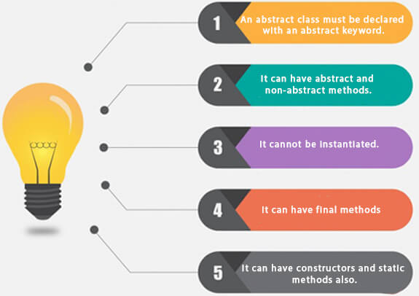
Abstract class in Java
[503005 Lecture 8: Abstract Class]

Slide 8
Abstract class in Java
Syntax
abstract class A
{
//attributes;
//methods;
}
[503005 Lecture 8: Abstract Class]

Slide 9
Abstract class in Java
Syntax
abstract class A
{
//attributes;
//methods;
abstract void printStatus();//no method body and abstract
}
[503005 Lecture 8: Abstract Class]

Slide 10
Examples
abstract class Bike
{
abstract void run();
}
class Honda4 extends Bike
{
void run(){System.out.println("running safely");}
public static void main(String args[])
{
Bike obj = new Honda4();
obj.run();
}
}
[503005 Lecture 8: Abstract Class]

Slide 11
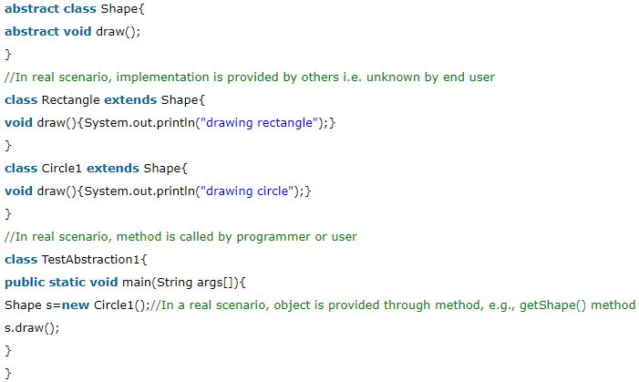

Examples
[503005 Lecture 8: Abstract Class]

Slide 12
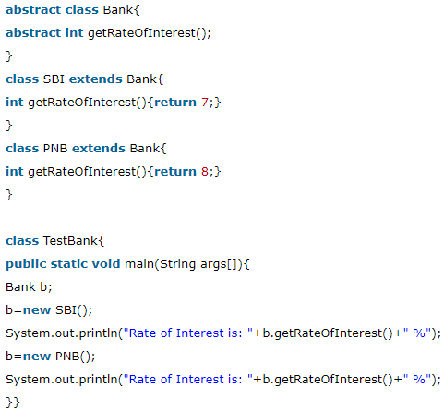

Examples
[503005 Lecture 8: Abstract Class]

Slide 13
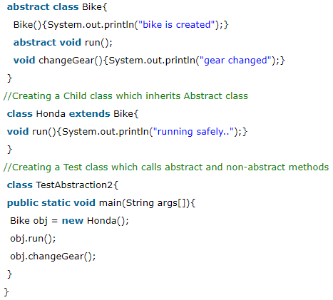

Examples
[503005 Lecture 8: Abstract Class]

Slide 14
Examples
[503005 Lecture 8: Abstract Class]

Slide 15
Notations
If there is an abstract method in a class, that class must be abstract.
If you are extending an abstract class that has an abstract method, you must either provide the implementation of the method or make this class abstract.
The abstract class can also be used to provide some implementation of the interface. In such case, the end user may not be forced to override all the methods of the interface.
[503005 Lecture 8: Abstract Class]

Slide 16
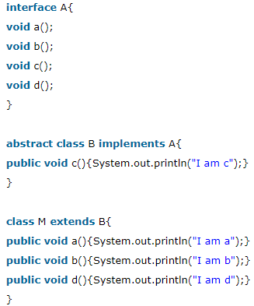
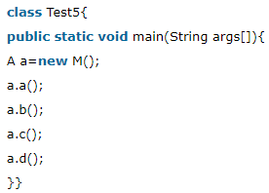

Examples
[503005 Lecture 8: Abstract Class]

